Slide 1
Principle and Operation of 3Ø Induction Motor

Slide 2
The stator of the motor consists of overlapping winding offset by an electrical angle of 120º.
When we connect the stator to a 3 phase AC source, it establishes rotating magnetic field which rotates at the synchronous speed.
According to Faraday’s law an emf induced in any circuit is due to the rate of change of magnetic flux linkage through the circuit.
As the rotor winding in an induction motor are closed and cut the stator rotating magnetic field, an emf is induced in the rotor copper bars
Due to this emf a current flows through the rotor conductor.
Here the relative speed between the rotating flux and static rotor conductor is the cause of current generation;
hence as per Lenz’s law, the rotor will rotate in the same direction to reduce the cause, i.e., the relative velocity.
it may be observed that the rotor speed should not reach the synchronous speed produced by the stator.
If the speeds become equal, there would be no such relative speed, so no emf induced in the rotor, and no current would be flowing, and therefore no torque would be generated

Slide 3
Consequently, the rotor cannot reach the synchronous speed.
The difference between the stator (synchronous speed) and rotor speeds is called the slip.
The rotation of the magnetic field in an induction motor has the advantage that no electrical connections need to be made to the rotor.
Thus the three phase induction motor is:
Self-starting.
Less armature reaction and brush sparking because of the absence of commutators and brushes that may cause sparks.
Robust in construction.
Economical.
Easier to maintain.

Slide 4
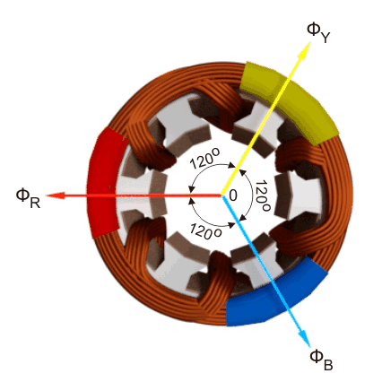
Rotating Magnetic Field
When we apply a three-phase supply to a three-phase distributed winding of a rotating machine, a rotating magnetic field is produced which rotates in synchronous speed.
The three-phase winding is physically distributed in the stator core in such a manner that winding of each phase is separated from other by 120º in space.
Although the vector sum of three currents in a balanced three-phase system is zero at any instant,
but the resultant of the magnetic fields produced by the currents is not zero rather it will have a constant non-zero value rotating in space
in respect to time.

Slide 5

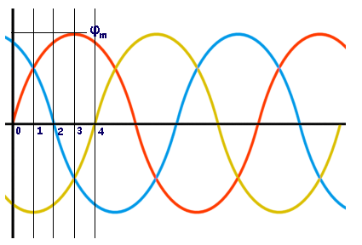
The magnetic flux produced by the current in each phase can be represented by the equations given below.
Where, φ_{R}, φ_{Y} and φ_{B} are the instantaneous flux of corresponding Red, Yellow and Blue phase winding, φ_{m} amplitude of the flux wave. The flux wave in the space can be represented as shown below.

Slide 6
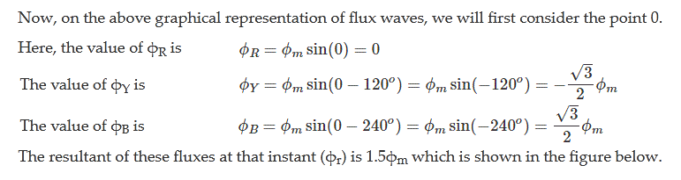
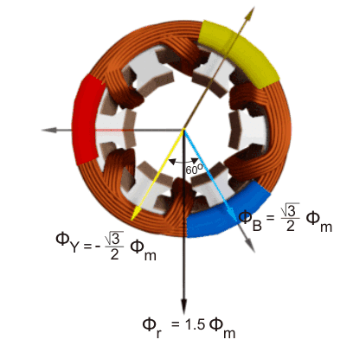

Slide 7
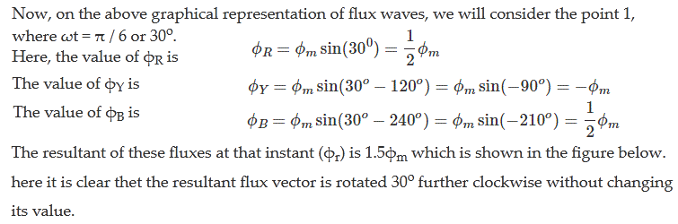
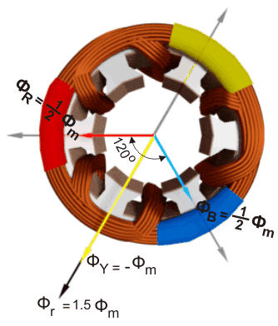

Slide 8
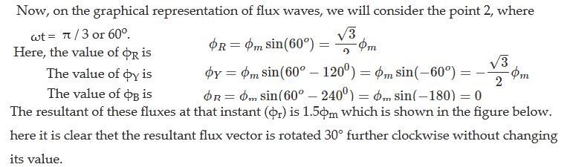
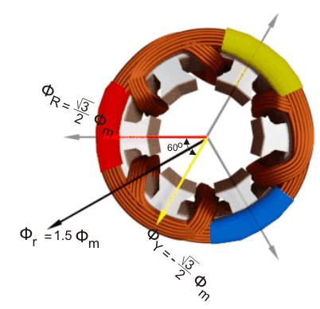

Slide 9
